Slide 1
Which Are The Most Valued Data Science Skills? Jayden Jiang, Sergio Belich
Data 607 Project 3

Slide 2
Introduction
Data science continues to grow in demand across industries
Skill sets required vary by region, company, and job level
Research question: “Which are the most valued data science skills?”
Analysis of job postings from multiple countries (U.S, U.K, Canada, Australia)
Goal: Extract insights about most frequently listed skills

Slide 3
Overall Project Approach
Data Collection & Loading
Word Tokenization
Word Classification
Labeling Original Data
Data Tidying & Transformation
Exploratory Data Analysis
See Detailed Methodology

Slide 4
Data Collection & Loading
Collected structured CSV dataset from LinkedIn/Kaggle
Dataset contains over 12,000 job postings
Key fields include:
Job title
Company
Location
Skills
Job level
Country
Load CSV dataset to R job_data <- read.csv("Data-Science Job Postings.csv") job_data <- job_data %>% filter(!is.na(job_skills)) %>% mutate(job_id = row_number())

Slide 5
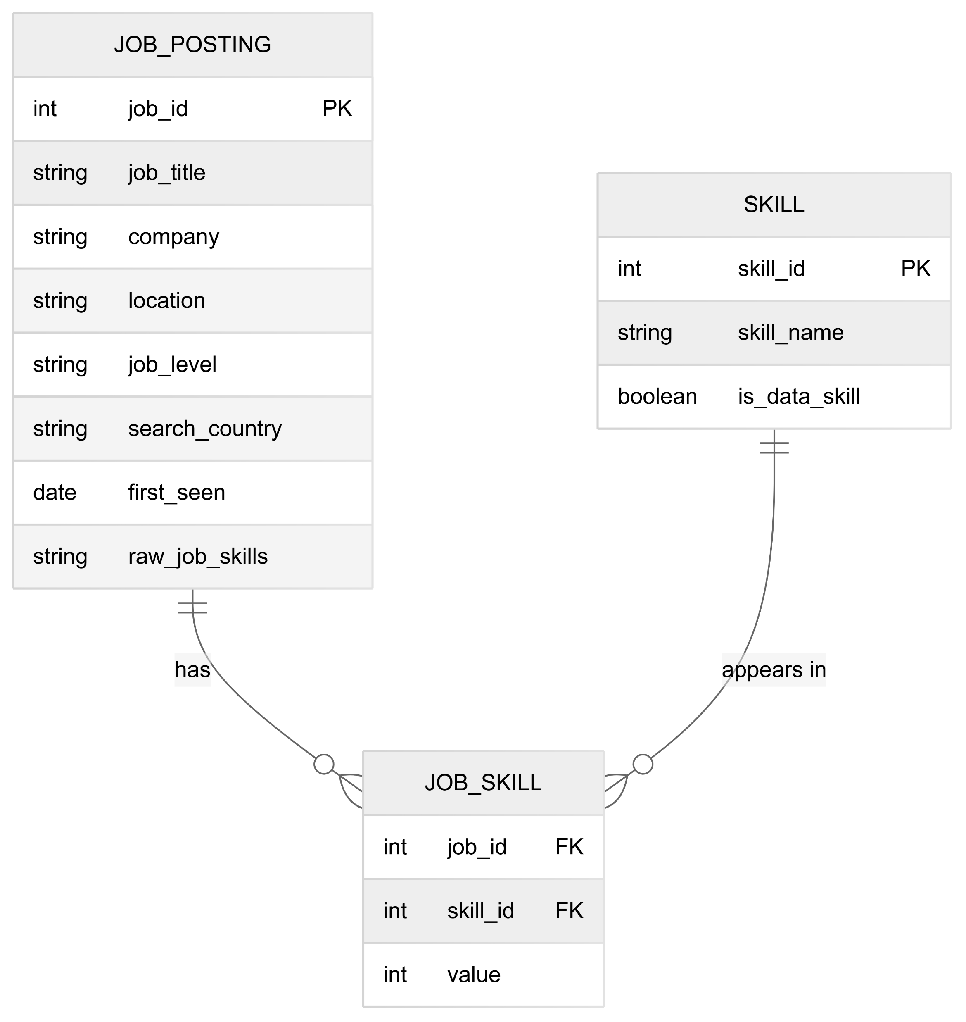
Entity Relationship Diagram

Slide 6
Word Tokenization
Process to break down the job_skills string field into individual skill tokens:
Normalize text encoding to UTF-8
Split skill strings using comma delimiters
Convert to lowercase for consistency
Remove special characters and excess whitespace
Filter out empty tokens

Slide 7
Tokenization of Skills
Step 1: Separate job_skills using commas as delimiters and trim left spaces
job_data <- job_data %>% mutate(job_skills = stringi::stri_enc_toutf8(job_skills, validate = TRUE)) %>% mutate(job_skills = str_trim(job_skills, side = "left"))
Step 2: Extract and clean individual skills skill_terms <- job_data %>% pull(job_skills) %>% tolower() %>% str_split(",") %>% unlist() %>% str_replace_all("[^a-z0-9 ]", "") %>% str_squish()

Slide 8
Tokenization of Skills
Step 3: Remove stop words and count term frequency
data("stop_words") skill_terms_clean <- tibble(term = skill_terms) %>% filter(term != "") %>% anti_join(stop_words, by = c("term" = "word")) %>% count(term, sort = TRUE)
job_data <- job_data %>% mutate(job_skills = stringi::stri_enc_toutf8(job_skills, validate = TRUE)) skill_tokens <- job_data %>% select(job_id, job_skills, search_country, company, job_level, first_seen) %>% separate_rows(job_skills, sep = ",") %>% mutate(skill = stringi::stri_trim_both(stringi::stri_trans_tolower(job_skills))) %>% filter(skill != "")

Slide 9
Tokenization of Skills
Top 20 Requested Skills
row_num | term
1 | python | 4814
2 | sql | 4612
3 | data analysis | 3296
4 | machine learning | 2688
5 | communication | 2507
6 | data visualization | 2331
7 | aws | 1742
8 | project management | 1738
9 | data engineering | 1715
10 | communication skills | 1714
row_num | term | n
11 | tableau | 1705
12 | data science | 1694
13 | data modeling | 1520
14 | data management | 1472
15 | java | 1435
16 | problem solving | 1411
17 | data analytics | 1410
18 | data warehousing | 1408
19 | spark | 1397
20 | teamwork | 1227

Slide 10
Word Classification
Method to identify and categorize relevant data science skills:
Count frequency of raw skill tokens
Export for manual review and classification
Create refined dictionary of core data science skills
Filter dataset to retain only relevant skills

Slide 11
Word Classification
Step 1 Create Frequency-based metrics term_metrics <- skill_tokens %>% count(skill, sort = TRUE) %>% rename(frequency = n) Step 2 Export terms to CSV for manual labeling write_csv(term_metrics, "term_metrics_for_labeling.csv")
Step 3 Extract the top N skills from skill_terms_clean top_n_skills <- 20 #starting with 20 top_skills <- skill_terms_clean %>% slice_head(n = top_n_skills) %>% pull(term)

Slide 12
Word Classification
Step 4 Create skill dictionary using these top skills skill_dict <- tibble( skill = top_skills, is_data_skill = TRUE ) Step 5: Now use skill_dict in classified_skills code classified_skills <- skill_tokens %>% left_join(skill_dict, by = c("skill" = "skill")) %>% filter(is_data_skill == TRUE)

Slide 13
Label Original Data
Process to prepare data for analysis:
Remove records with missing skill information
Assign binary indicators (1) for skills present in job postings
Create a job-skill matrix for analysis
Each row represents a job, columns represent skills

Slide 14
Label Original Data
Step 1: Remove NAs labeled_skills <- classified_skills %>% filter(!is.na(skill)) Step 2: Match labeled skills to job posts and tag as 1 if present labeled_skills <- labeled_skills %>% mutate(value = 1)
Step 3: Create job-skill matrix for analysis job_skill_matrix <- labeled_skills %>% select(job_id, skill, value) %>% distinct() %>% pivot_wider( id_cols = job_id, names_from = skill, values_from = value, values_fill = list(value = 0) )

Slide 15
Data Tidying & Transformation
Steps to prepare data for visualization and analysis:
Converting wide-format job-skill matrix to long format
Filtering to include only jobs with specific skills
Joining with metadata (country, company, job level)
Creating analysis-ready dataset for visualization

Slide 16
Tidy Data
Covert to long format for analysis
job_skill_long <- job_skill_matrix %>% pivot_longer( cols = -job_id, names_to = "skill", values_to = "has_skill" ) %>% filter(has_skill == 1) %>% left_join(job_data %>%
select(job_id, search_country, company,
job_level), by = "job_id")
head(job_skill_long, 10)
## # A tibble: 10 × 6 ## job_id skill has_skill search_country company job_level ## <int> <chr> <dbl> <chr> <chr> <chr> ## 1 1 machine learning 1 United States Jobs for Huma… Mid seni… ## 2 1 python 1 United States Jobs for Huma… Mid seni… ## 3 1 java 1 United States Jobs for Huma… Mid seni… ## 4 1 data engineering 1 United States Jobs for Huma… Mid seni… ## 5 1 data visualization 1 United States Jobs for Huma… Mid seni… ## 6 1 spark 1 United States Jobs for Huma… Mid seni… ## 7 2 python 1 United States Aurora Mid seni… ## 8 2 communication skills 1 United States Aurora Mid seni… ## 9 3 data warehousing 1 United States Adame Service… Associate ## 10 3 data modeling 1 United States Adame Service… Associate

Slide 17
Exploratory Data Analysis
Key analyses performed on the processed data:
Geographic comparison
Skill demand variation across countries
Regional specialization patterns
Employer expectations
Skills clustered by company size/type
Industry-specific requirements
Job level trends
Entry-level vs. senior position requirements
Career progression skill pathways
Visualization techniques
Bar charts for frequency analysis
Faceted plots for country comparisons

Slide 18
Analysis of Data
Top 10 data science skills requested across all countries
top_skills_all <- classified_skills %>% count(skill, sort = TRUE) %>% slice_head(n = 10)

Slide 19
Analysis of Data
Create a bar chart top_skills_plot <- ggplot(top_skills_all, aes(x = reorder(skill, n), y = n, fill = skill)) + geom_col() + coord_flip() + labs( title = "Top 10 Most Requested Data Science Skills", subtitle = "Based on job posting analysis across all countries", x = "Skill", y = "Number of Job Postings", caption = "Data source: LinkedIn/Kaggle job postings dataset" ) + theme_minimal() + theme( plot.title = element_text(face = "bold", size = 14), axis.title = element_text(face = "bold"), legend.position = "none", plot.margin = margin(0.5, 0.5, 0.5, 0.5, "cm") ) + scale_fill_viridis_d(option = "D") assign("saved_plot", top_skills_plot, envir = .GlobalEnv)

Slide 20
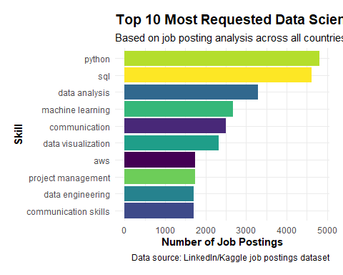
Visualization of Top Skills
print(saved_plot, width = 10, height = 6)

Slide 21
Skills by Country
# Filter for major countries with sufficient data major_countries <- c("United States", "United Kingdom", "Canada", "Australia", "Germany", "India") # Get top skills by country skills_by_country <- classified_skills %>% filter(search_country %in% major_countries) %>% count(search_country, skill, sort = TRUE) %>% group_by(search_country) %>% slice_max(order_by = n, n = 10) %>% ungroup()

Slide 22
Skills by Country
# Create a faceted bar chart for top skills by country ggplot(skills_by_country, aes(x = reorder_within(skill, n, search_country), y = n, fill = search_country)) + geom_col(show.legend = FALSE) + coord_flip() + facet_wrap(~ search_country, scales = "free_y") + scale_x_reordered() + # Required for reorder_within labs( title = "Top 10 Data Science Skills by Country", subtitle = "Based on job posting analysis", x = "Skill", y = "Number of Job Postings", caption = "Data source: LinkedIn/Kaggle job postings dataset") + theme_minimal() + theme( plot.title = element_text(face = "bold", size = 14), axis.title = element_text(face = "bold"), strip.background = element_rect(fill = "lightgray"), strip.text = element_text(face = "bold"), plot.margin = margin(0.5, 0.5, 0.5, 0.5, "cm"))

Slide 23
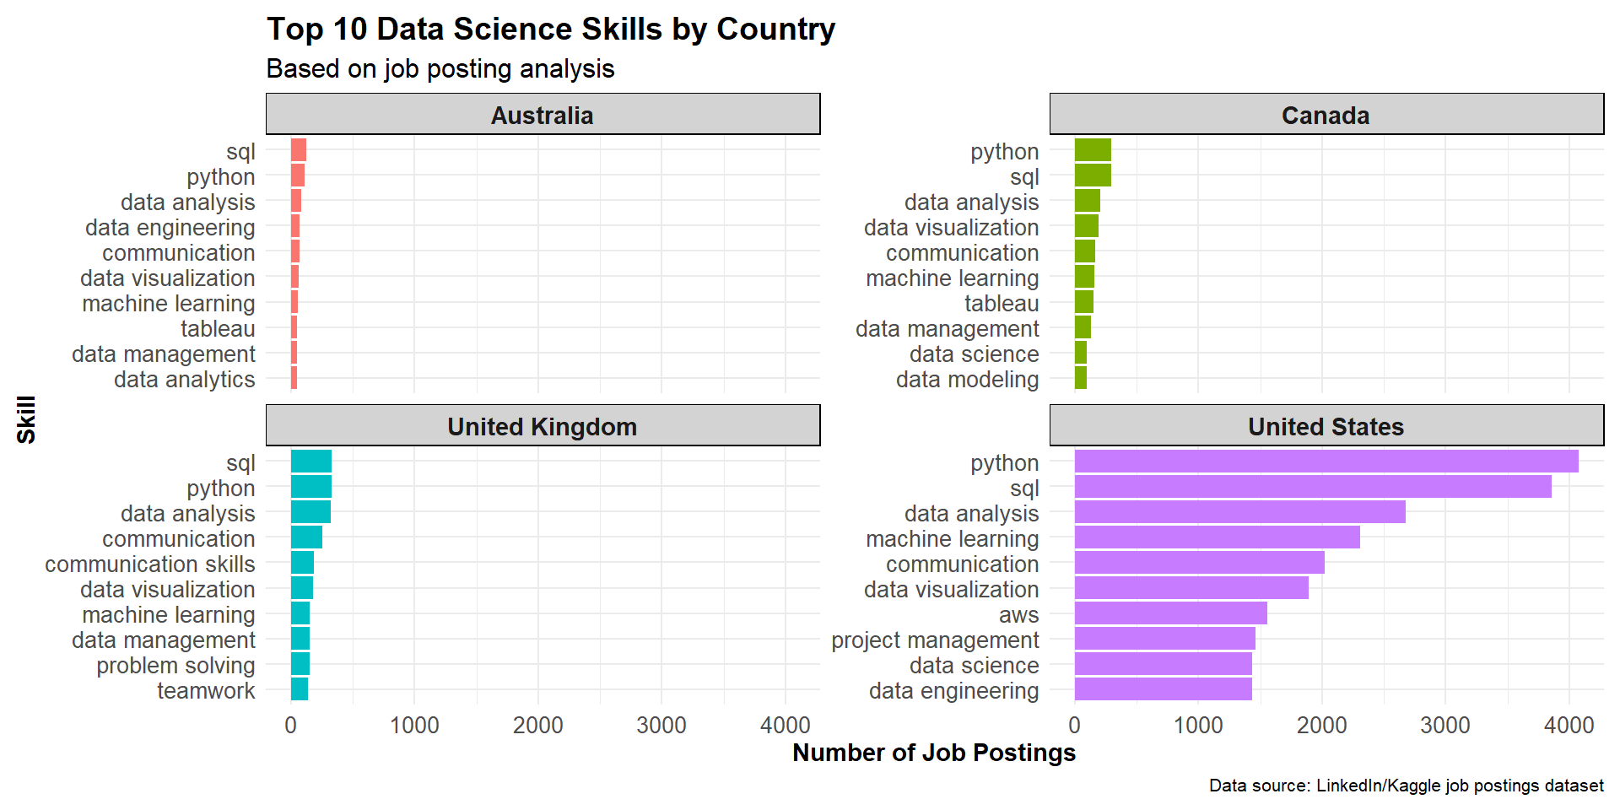
Skills by Country

Slide 24
Conclusions
Python, SQL, and R are consistently among the top requested skills globally
Technical skills dominate the rankings across all countries
Regional variations exist in the importance of specific skills
Communication skills rank highly despite being a soft skill
Cloud platforms (AWS) have significant presence in job requirements

Slide 25
Next Steps
Analyze skill trends over time
Investigate skill correlations and clusters
Compare entry-level vs. senior position requirements
Develop skill recommendation system for data science professionals
Expand analysis to include salary data and skill premiums

